Slide 1
SCRUM DEVELOPMENT & EXECUTION PROCESS

Slide 2
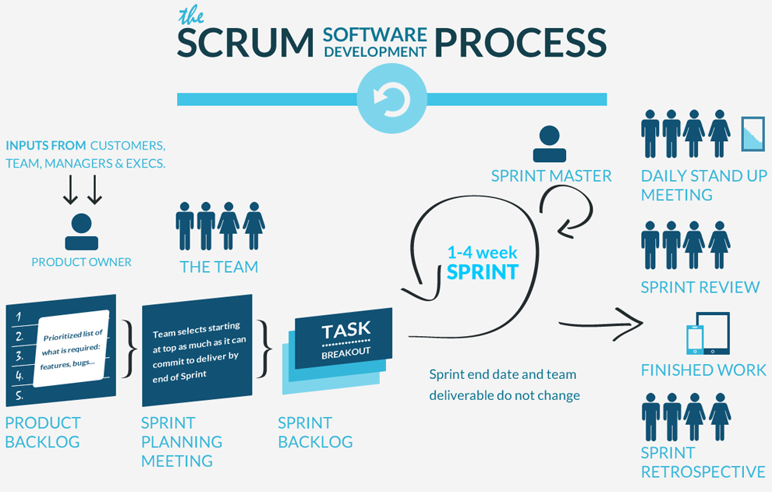
Development process

Slide 3
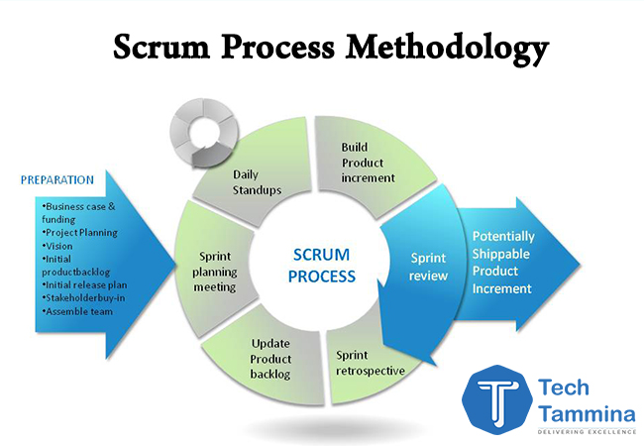
SCRUM EXECUTION PROCESS

Slide 4
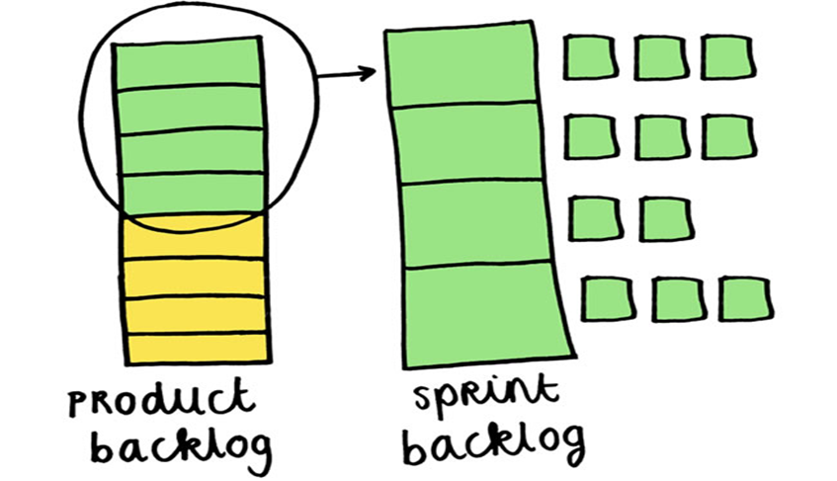
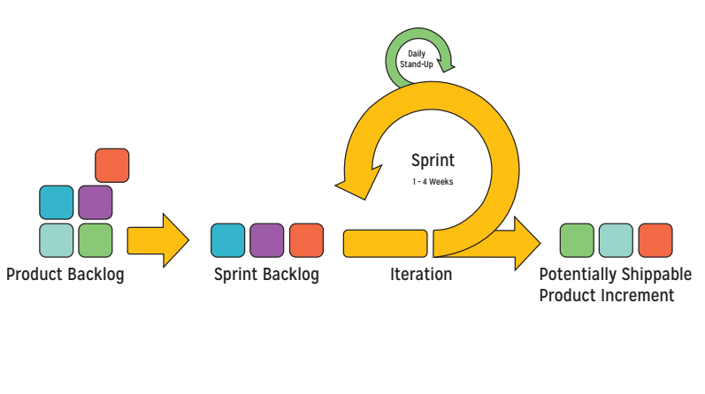
SCRUM ARTIFACTS
Scrum describes three primary artifacts:
1. The Product Backlog
2. The Sprint Backlog
3. Burn – Down chart
4. The Product Increment

Slide 5
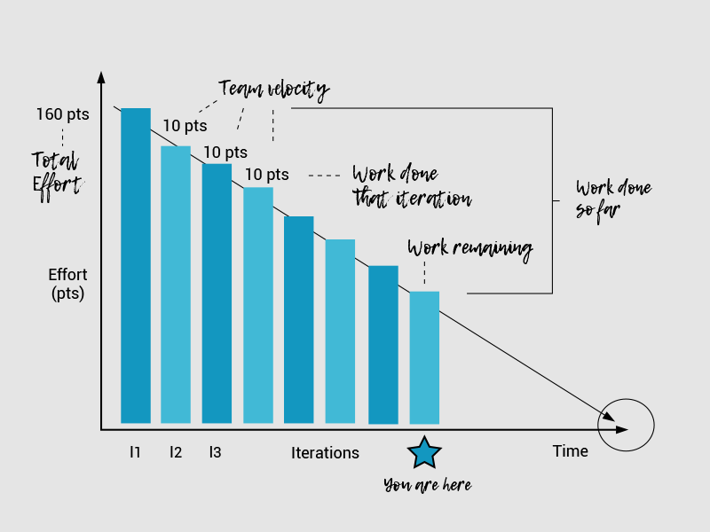

Slide 6
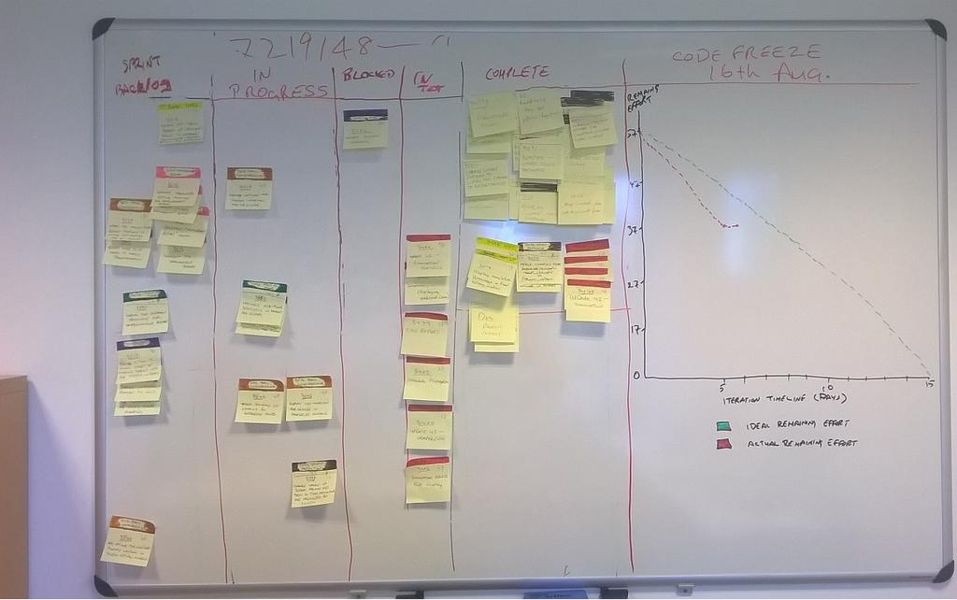

Slide 7
